Slide 1
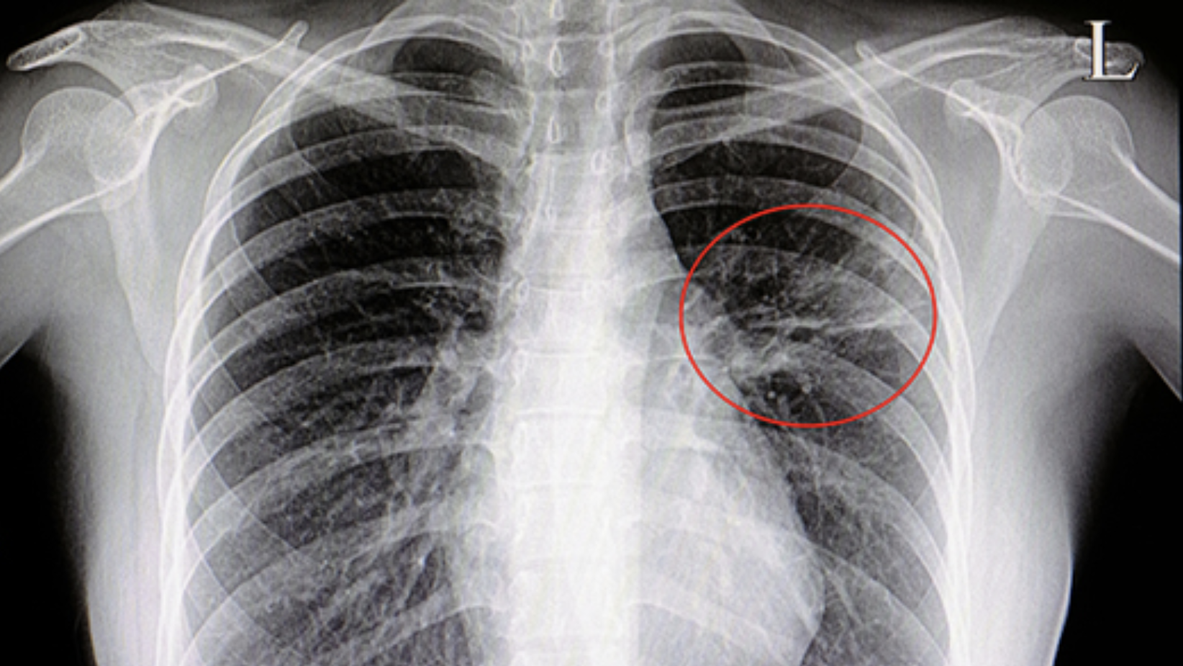
Flatiron school module 4 project
Chest X-Ray Images (Pneumonia) Deep Learning Project
Christian Lopez
Notes:
I’ll be presenting my module 4 project
I built a deep learning image classifier using the Chest X-Ray Images dataset from Kaggle

Slide 2
Problem statement:
Delays in response time
Diagnostic process failures
Cost-efficiency of medical institution
Notes:
Delays in response time can lead to customer dissatisfaction
Process failures in the diagnostic procedure can cause the patient’s health to be compromised. May prevent the patient from seeking the help they need.
The medical institution may be making unnecessary expenditures. Having a more streamlined approach can lead to significantly better outcomes for both the institution and the patient.

Slide 3
Business value:
Quicken response-time for diagnosis
Streamline diagnosing procedure
Increased ROI for the medical institution
Notes:
Quickening the response time for a diagnosis allows for greater customer satisfaction. The customer can receive their diagnosis in a timely manner which ensures they seek the treatment they need right away.
Streamlining and automating the diagnosing procedure guarantees efficiency
The medical institution is assured with an increase in ROI. They can utilize the neural network in classifying patients with or without pneumonia without having a doctor do the work.

Slide 4
Methodology: (osemn)
Obtain: Chest X-Ray Images (Pneumonia) Dataset
Scrub: manipulated data using Pandas, NumPy, OS
Explore: Created visualizations using Matplotlib, Seaborn, Plotly
Model: Keras used to create image classifier neural network
Interpret: Drew conclusions from model results
Notes:
Utilized the chest x-ray images dataset from Kaggle
Manipulated the data using Pandas, NumPy, and OS
Created visualizations using Matplotlib, Seaborn, and Plotly
Used Keras to create the image classifier
Drew conclusions from the results obtained by the model

Slide 5
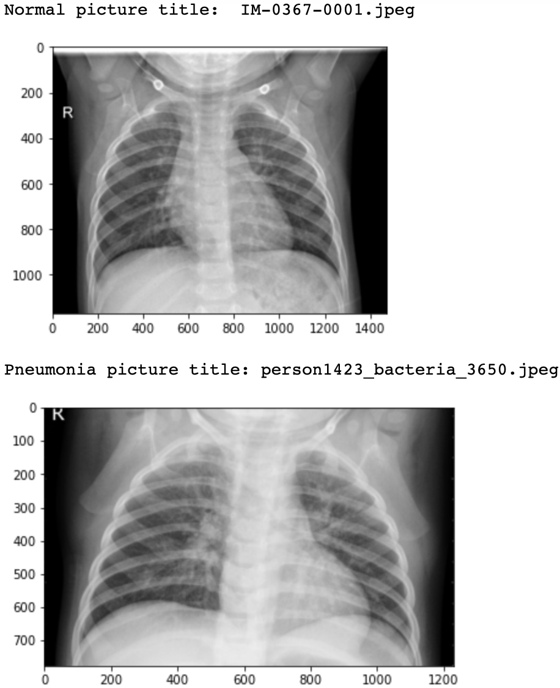
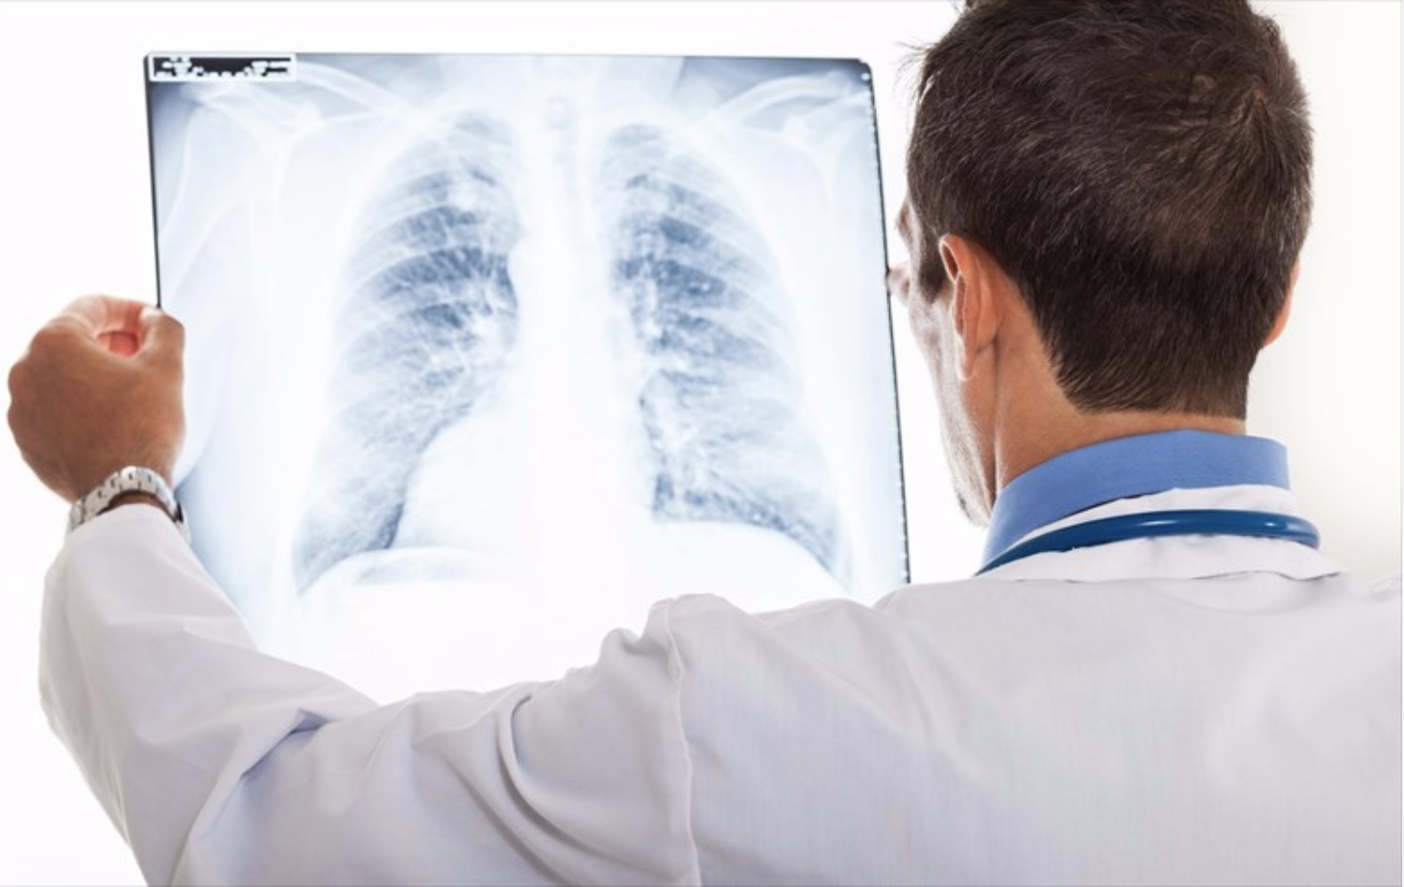
Recommendation 1:
Incorporate neural network
Allows for quicker response-time
Increased customer satisfaction
Notes:
Incorporate the neural network into the daily workflow as soon as possible
Patients will see a significant increase in response-time pertaining to their diagnostic outcomes
And as a result, their customer satisfaction will be through the roof

Slide 6

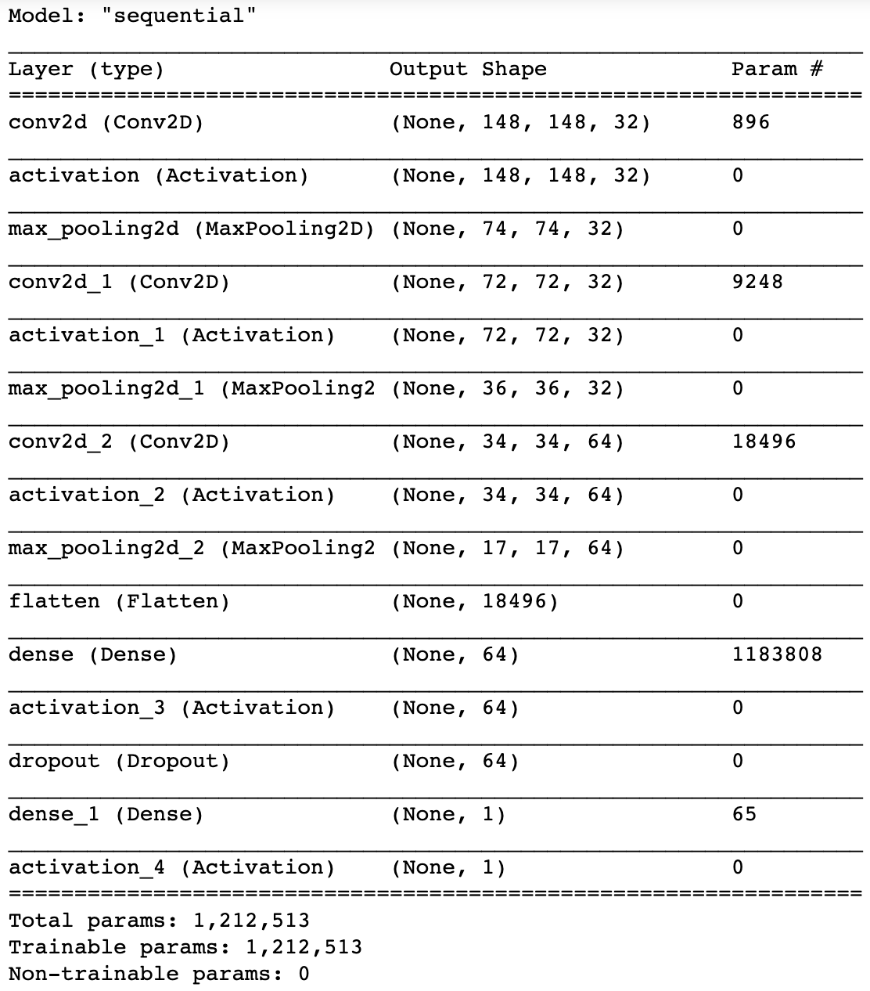
Recommendation 2:
Feed it as many images as you have access to
Allow the model to work with as much training data as is available
Will automate the diagnosis process
Notes:
Feed the neural network as many images as possible
This will allow the model to work with as much training data as is available, which in turn will yield better results on the test data
The doctors will be allowed more time to focus on more pressing tasks while the neural network does its job in the background

Slide 7

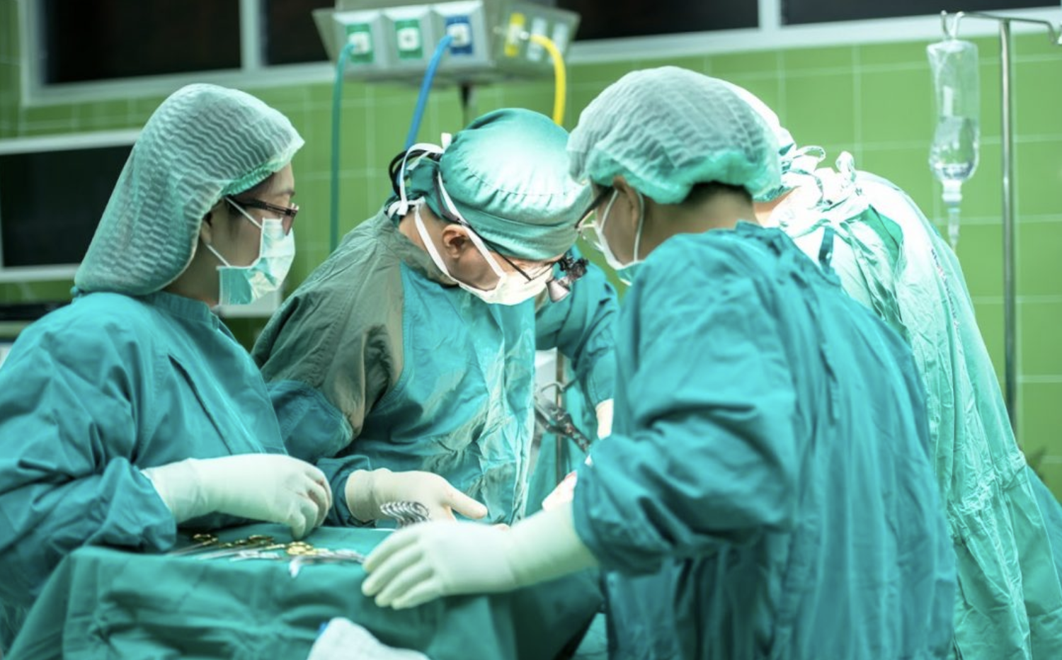
Recommendation 3:
Doctors given the opportunity to focus on more demanding procedures
Hospitals and medical institutions can hire accordingly
Will increase ROI for these institutions
Notes:
Doctors will not suffer through having to sift through countless images on a day-to-day basis. This can lead to careless mistakes being made due to tired eyes.
Hospitals and medical institutions can begin to hire accordingly
Having one less task to have to worry about will free up equity, which they can make use of elsewhere

Slide 8
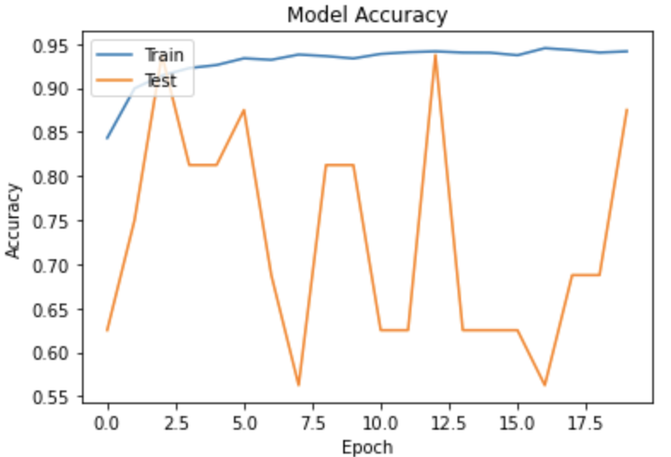
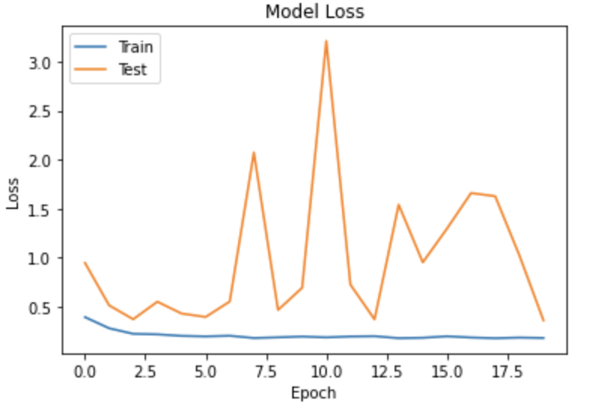
MODEL EVALUATION/RESULTS:
Notes:
- The model metrics overall were relatively promising
The model accuracy was particularly high at about 90%
The model loss was quite low at around 36%
I decided to go with accuracy as the evaluation metric because it’s extremely helpful in classification projects when comparing classified images to validated images that serve as ground truth.
With model loss (binary crossentropy), we always attempt to minimize as much as possible during training. The lower the loss, the closer our predictions are. To the true labels.

Slide 9
Future work:
Tune more hyperparameters
Add more layers to the neural network
Increase training data
Notes:
Play around with the number of epochs and batch sizes
Add more layers to the neural network
Feed it more training data and see if the model improves

Slide 10

Thank you
Notes:
- Thank you

